Slide 1

X Education - Lead Scoring Case Study
Identification of Hot Leads to focus more on them and thus enhancing the conversion ratio for X Education

Slide 2

Background - X Education Company
X Education , An education company named sells online courses to industry professionals
Many interested professionals land on their website
The company markets its courses on several websites like Google. Once these people land on the website, they might browse the courses or fill up a form for the course or watch some videos

Slide 3

Background - X Education Company
When these people fill up a form providing their email address or phone number, they are classified to be a lead
Once these leads are acquired, employees from the sales team start making calls, writing emails, etc. Through this process, some of the leads get converted while most do not
The typical lead conversion rate at X education is around 30%

Slide 4

Problem Statement - X Education Company’s Problem
X Education gets a lot of leads but its lead conversion rate is very poor
To make this process more efficient, the company wishes to identify the most potential leads, also known as ‘Hot Leads’
If they successfully identify this set of leads, the lead conversion rate should go up as the sales team will now be focusing more on communicating with the potential leads rather than making calls to everyone

Slide 5

Problem Statement - X Education Company’s Problem
We will help them to select the most promising leads, i.e. the leads that are most likely to convert into paying customers.
We are required to build a model wherein we need to assign a lead score to each of the leads such that the customers with higher lead score have a higher conversion chance
The CEO, in particular, has given a ballpark of the target lead conversion rate to be 80%.

Slide 6
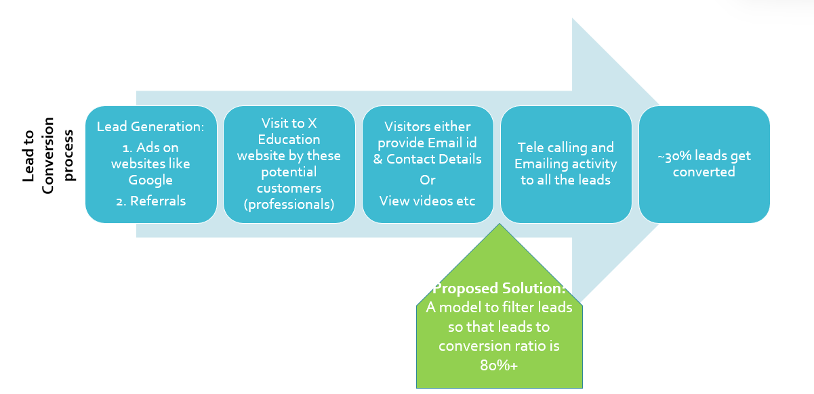
Lead – Conversion Process

Slide 7
Proposed Solution
Selection of Hot Leads
Communicating with Hot Leads
Conversion of Hot Leads
Leads Clustering
Based on the leads' propensity or likelihood to convert, we cluster them into different groups, resulting in a more narrowly focused group of hot leads.
Focus Communication
We might have a smaller pool of leads to communicate with, which would allow us to have a greater influence.
Increase conversion
We would have a higher conversion rate and be able to meet the 80% target because we concentrated on hot leads that were more likely to convert.

Slide 8
Propossed Solution Selection of Hot Leads
The most important step in implementing our Problem Solution is correctly identifying hot prospects.
The likelihood of a higher conversion rate increases with the accuracy with which we acquire the hot lead.
Since we want to achieve an 80% conversion rate, we'd like to find hot prospects with great accuracy.

Slide 9

Implementation

Slide 10
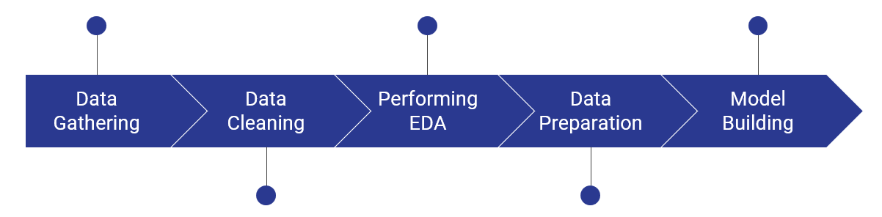
Lead – Conversion Process
Loading & Observing the previous data
Univariate, Bivariate, and Heatmap for numerical and categorical columns
Performing pre-requisites for RFE and Logistic Regression
Duplicate removal, null value treatment, unnecessary column elimination, etc.
Outlier Treatment, Feature-Standardization

Slide 11
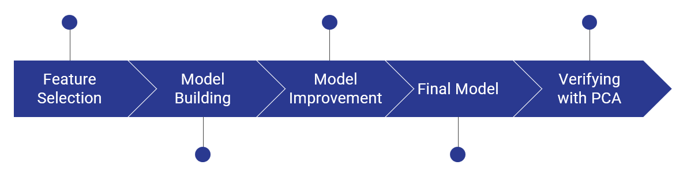
Lead – Conversion Process
Verifying our Final Model Accuracy etc. with model built with PCA
Selection of top 25 features using RFE
Reduction of columns and Model re-building
Model building using RFE for selected columns
Final Model Analysis and performance on Test Data

Slide 12

Plots (Visualization)

Slide 13
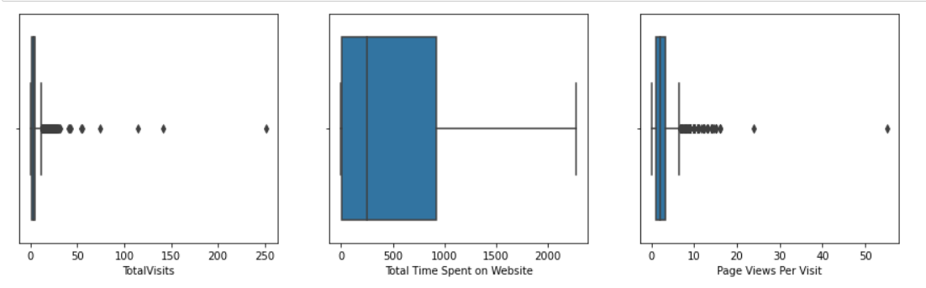
Few outliers in "Total Visits" and "Page Views Per Visit" columns, however there are no outliers in "Total Time Spenton Website
Therefore removing the outliers in 10th and 90th percentile.

Slide 14
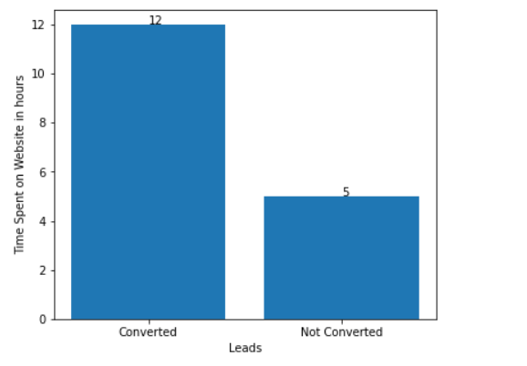
Average Leads of the converted and not converted customers

Slide 15
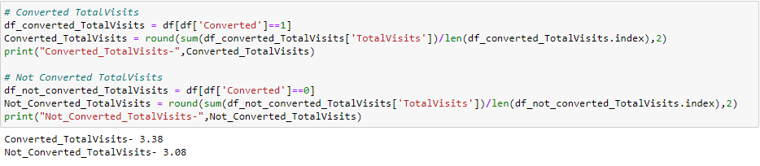

Slide 16
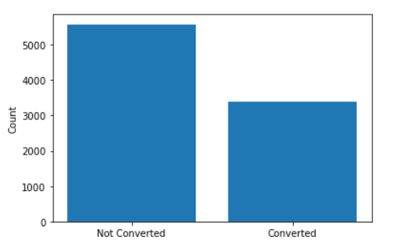
Count of converted and not converted customers

Slide 17
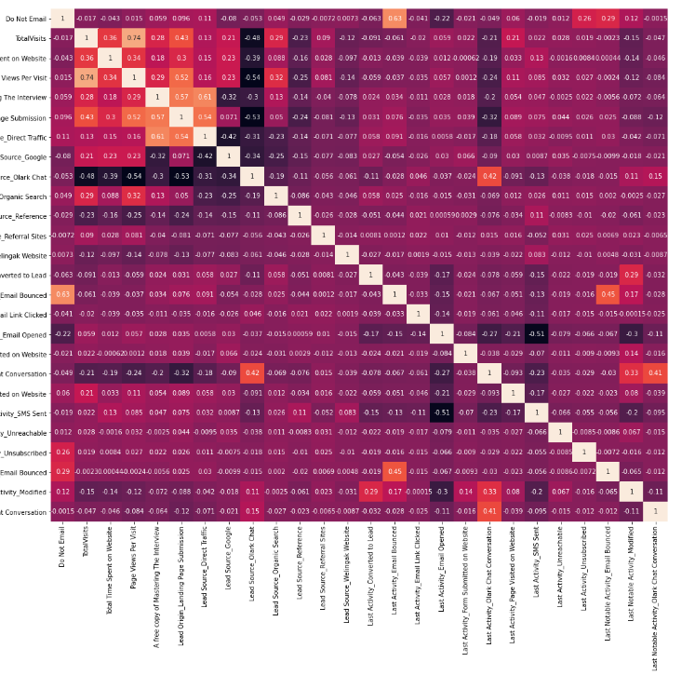
EDA plots depicting correlation (Heat Map)

Slide 18
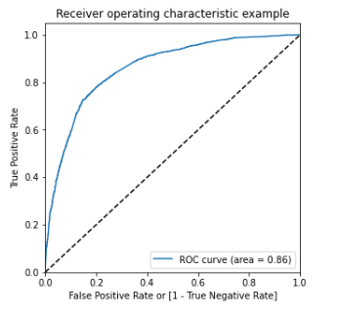
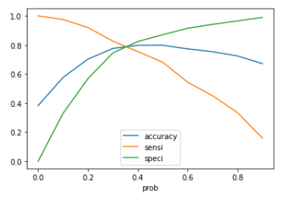
Analysis of the above curve Accuracy - Becomes stable after 0.425
At point 0.425 where the three parameters cut each other, we can see that there is a balance between sensitivity and specificity with a good accuracy.
So, 0.425 may be the optimal cutoff.
Gini of the model We can see from the ROC curve, that the area of the curve is 0.86, which is the Gini of the model.

Slide 19

Inference/Conclusion

Slide 20
Model Analysis - Performance of our Final Model
Overall accuracy on Test set: 0.79
Sensitivity of our logistic regression model: 0.72
Specificity of our logistic regression model: 0.83

Slide 21
Business Insights Derived from our Model
Top 3 variables in model, that contribute towards lead conversion are:
Total Time Spent on Website
Last Notable Activity_SMS Sent
TotalVisits

Slide 22
Business Insights Derived from our Model
Top 3 variables in my model, that should be focused are:
Last Activity_SMS Sent (positively impacting)
Last Activity_Olark Chat Conversation (negatively impacting)
Lead Source_Olark Chat (negatively impacting)

Slide 23
Conclusion 1 (LR Model)
When compared to the model developed using PCA, our Logistic Regression Model is decent and accurate enough, with 0.79 Accuracy on Test Set, 0.72 Sensitivity, and 0.83 Specificity.
By adjusting the cut-off value, we can change these parameters and forecast Hot leads based on situations like the availability of additional resources and vice versa.

Slide 24
Conclusion 2 (Recommendation)
Focus on
To raise the total conversion rate, X Education Company must concentrate on the following important factors:
Increase
Boost website customer interaction because it will increase conversion
Increase on
Sending SMS messages more frequently will increase conversion.
Get
Get more visitors overall through marketing, etc., as this will boost conversion
Improve
Improve Olark Chat as it is having a detrimental impact on conversion.

Slide 25
Thank you
Group Members:
Hema Kiran
Hemant singh fartyal
Ritesh singh

